Slide 1
Stop telling me what to do
Evoking your patients’ motivation

Slide 2
My training
1
2
3
4
Assess
Find the problem
Offer solutions
Instruct how to implement solutions

Slide 3
?

Slide 4
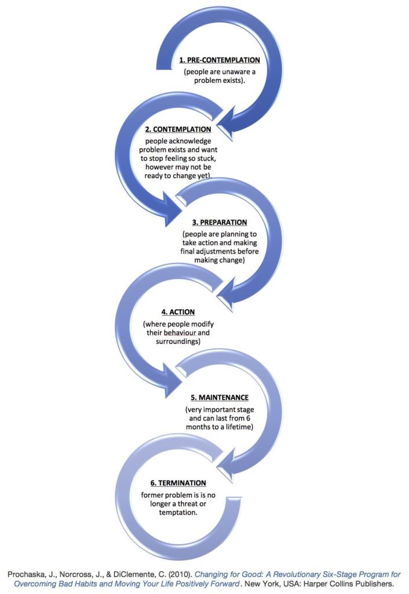

Slide 6
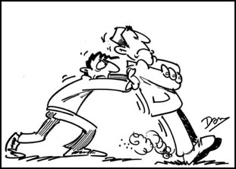
Could my well intentioned efforts be hindering intrinsic motivation?

Slide 7
Objectives
MI Basics
Methods of Motivational Interviewing
Engagement
Focusing
Evoking
Planning

Slide 8
I am already tired when I get home. I know I need to exercise but by the time I make dinner and get the kids to bed it is late and I am exhausted.

Slide 9
Go for a walk on the weekend
Go for a walk at lunch
10 minute bouts count
Use an app to track your steps
Play outside with kids
Turn on the music and dance
Get up 20 minutes earlier
You’ll sleep better and have more energy

Slide 10
“A natural and instinctive response of trained care providers is to fix the problem, make things right, to use knowledge acquired from training and experience to help the individual seeking care to overcome their problems.”
-Miller and Rollnick

Slide 11
Motivational interviewing is a collaborative conversation style for strengthening a person’s own motivation and commitment to change.

Slide 12
Spirit of MI

Slide 13
MI is directive
Start
Outcome is change
End

Slide 14
Ambivalence
Ambivalence is . . .
simultaneously wanting and not wanting something or wanting two incompatible things
A normal part of change

Slide 15
People who are ambivalent
Can describe the merits of making the change
Are well aware of the downside of their behavior
Still have motives that conflict with “doing the right thing”
The most common place to get stuck is ambivalence.

Slide 16
People already have the arguments
FOR
AGAINST
the change within them

Slide 17
Clinician sides with change
Patient argues the other side
People are persuaded by what they hear themselves say

Slide 18
MI is about arranging conversations so that people talk themselves into change, based on their own values and interests.

Slide 19
Method of MI

Slide 20
Engaging
More than just being friendly

Slide 21
Engaging
Establish a collaborative a working relationship
Prerequisite for everything that follows
Influenced by factors both in/outside of our control.
Patients might consider?
Does this person listen and understand me?
Do I trust this person?
Do I have a say in what happens in this appointment?
I’m I being offered options rather than one-size fits all
approach?

Slide 22
Disengagement traps
Assessment
“If I ask enough questions then I’ll know what to tell the patient to do”
Expert
“I tell them and I tell them and I tell them and they still don’t change.”
“Just do this . . .”

Slide 23
Assessment
How much information is really essential?
Keep to necessary minimum
Make it useful to client and clinician
Completion of forms at a different time
Open-ended questions
Outline expectations

Slide 24
Assessment
“I need to collect some background information and there are a couple of safety things we need to cover. First I’d like to know what you want to talk about today?”

Slide 25
Disengagement traps
Premature Focus
Focusing before engaging—trying to solve the problem before a working alliance is established and common goals are agreed upon.
Chatting

Slide 26
Core Interviewing Skills
OARS

Slide 27
Core Interviewing Skills
O pen Ended Questions
A ffirmations
R eflections
S ummaries

Slide 28
Open ended questions
What are you hoping to get from this visit?
What concerns you about . . . ?
Tell me about . . .
What has been like for you?

Slide 29
Affirming
Stating strengths, efforts, intentions
Increase confidence and hope
More specific than “good job”
Avoid using “I”—instead focus on “you” statements

Slide 30
Affirming
You continued to monitor BG even when the numbers were not what you wanted. That takes persistence.
You made time to walk twice this week. Nice planning.
You adjusted your insulin dose correctly. Great problem solving skills!
Tell me what went well.
Thanks for being here.

Slide 31
Reflections
Move the conversation forward
Substantial portion of responses during engagement
Summarizes what a person means
“I’m doing everything right but my numbers are still high.”
“You’re frustrated.”

Slide 32
Reflections
Simple
Repeating content
Complex
Interpret meaning to what they have said
Amplified
“zoom-in”
Double-sided
Reflect both sides of ambivalence
Metaphor
Use metaphor to reflect

Slide 33
Summaries
Pulls together several things that someone has said
Choose to highlight certain aspects and pass over others
Allows person to hear a summary of what they said
“Let me see if I’m understanding . . .”
Summary of reflections
“Tell me about . . .”

Slide 34
Focusing
Finding direction

Slide 35
Focusing
Develop and maintain a specific direction in the conversation about change
Clarifies direction, sets agenda
“ You’ve mentioned that you’d like to talk about . . . , we also need to make a little time to touch base about . . .
What would you like to talk about first?”

Slide 36
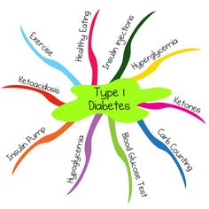
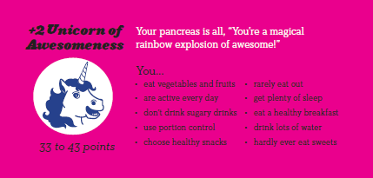
Agenda mapping

Slide 37
Exchanging information
Elicit
What information do they already have?
What have they already tried?
Provide
Prioritize most important
Small amounts of information, clear, concise
Elicit
Patient’s interpretation, understanding, response
“What questions do you have?”

Slide 38
Exchanging Information
Ask permission before offering advice
Emphasize autonomy
“Can I share some things that have worked for other people?”
“This may or may not work for you”

Slide 39
Evoking
Talking oneself into change

Slide 40
Evoking
Patient voices his/her arguments for change
Why and how they might change
A person’s own arguments for change are more persuasive than whatever arguments we might be able to provide.
Notes:
Expert model is appropriate in acute medicine—here’s the problem, let’s try this. When the goal is personal change requires the individuals active participation in the change process. Evoking is having eh person voice the arguments for change. The righting reflex is to voice these arguments oneself but it can be counter productive. People talk themselves into changing and are commonly disinclined to be told what to do if it conflicts with their own judgement.
Harness the clients own ideas and feelings about why and how they might do it
Some people come in fully prepared for change and asking for the best advice on how to proceed. Then you move into planning.
Component skills include recognizing change talk and knowing how to evoke and respond to it
Skillful MI significantly strengthens client change talk which in turn predicts subsequent change
People are more powerfully influenced by what they hear themselves say than by what someone else says to them
Important not to get ahead of client’s readiness for change
Predominance of sustain talk or an equal mix of change and sustain talk is associated with maintenance of the status quo
Predominance of change talk predicts behavior change
Sustain talk- listened to, respected, reflected and included in the larger picture
However there is an intential arranging of
Talking oneself into change
People become more committed to what they hear themselves saying
Any self-expressed language that is an argument for change

Slide 41
Evoking change talk
Change talk
Change
We can influence the amount of change talk
Ask for change talk

Slide 42
Change talk
Preparatory
Desire
Ability
Reasons
Need
Mobilizing
Commitment
Activation
Taking steps

Slide 43
Change talk
Desire
How would you like for things to change?
What do you wish . . . looked like?
Ability
If you decided to start . . . , how would you go about it?
Of the options you are considering, what seems most doable?
Reasons
Why would you want to . . .?
What’s the downside of . . .?
Need
What needs to happen?
How important does it feel to you to . . .?

Slide 44
Mobilizing change talk
Commitment
Is this what you intend to do?
Activation
How ready are you to do that?
Taking steps
What would be your first step?
How would you go about doing . . .?

Slide 45
Readiness Ruler

Slide 46
Evoking change talk
Query extremes
Looking forward/looking backwards
Magic wand scenario
Exploring goals and values

Slide 47
Decisional Balance

Slide 48
Responding to change talk
Open-ended questions
Elaboration—how, what would it look like, why, examples
Affirmations
Encouragement, past successes
Reflections
Reinforce change talk
Summaries

Slide 49
A predominance of change talk predicts behavior change.

Slide 50
Planning
Moving forward

Slide 51
Planning
Increased change talk
Decreased sustain talk
Envisioning
Questions about change

Slide 52
Developing a change plan
Continue OARS
Set SMART goals
Contingency planning
“How will you know how it is going with your goal?”
“What are one or two things you can do if things get off track?”

Slide 53
I am already tired when I get home. I know I need to exercise but by the time I make dinner and get the kids to bed it is late and I am exhausted.

Slide 54
I am already tired when I get home. I know I need to exercise but by the time I make dinner and get the kids to bed it is late and I am exhausted.

Slide 55
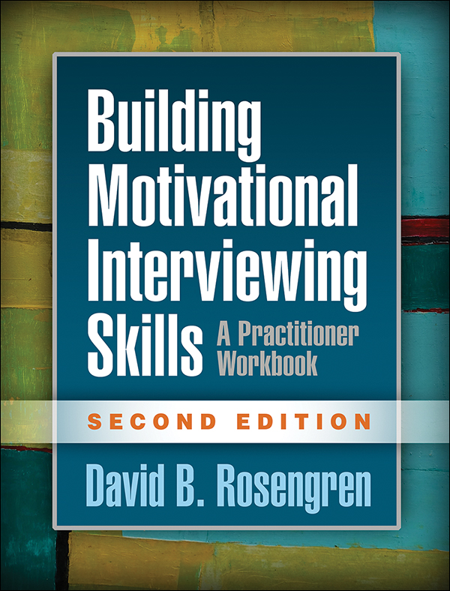
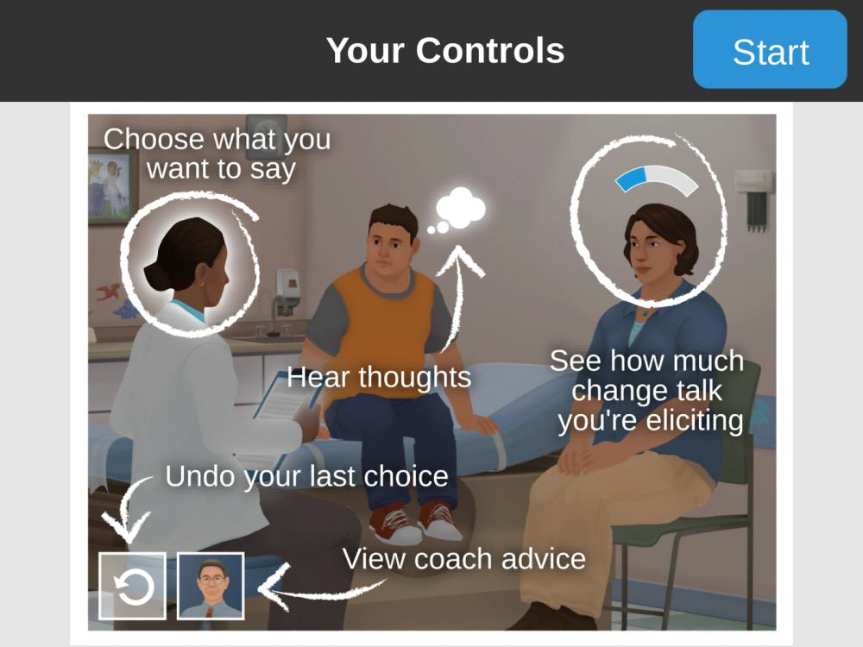
Learning more
http://motivationalinterviewing.org/

