Slide 1
Bridging the Gap Between Clinical Nutrition & Intuitive Eating/HAES
Robyn Nohling, FNP-BC, RD, LDN, MSN

Slide 2
How I got here…
2012 → began career as dietitian in alternative and “holistic” medicine
Passion for the therapeutic effect of food, but not yet discovered IE/HAES
2013 → started women’s telemedicine practice & work in the ED field
Was introduced to IE and the HAES paradigm
2014 → went back to school to become a Nurse Practitioner
Bridged therapeutic effect of food with IE/HAES as I simultaneously combined my nursing and dietetics education into my practice

Slide 3
How we got here…
Growth of diet culture over the past several decades
Our education system is rooted in diet culture
Belief systems are reinforced by family, friends, media, workplace and insurance policies
Fat is bad, thin is good
Fat people are responsible for their size
Pathologize people in larger bodies (the word obesity)
Solution to chronic health problems and premature death is weight loss
Our own weight and health bias – both conscious and subconscious
Resistance to admit that maybe….we’ve been doing it wrong

Slide 4
6 Steps to Bridge the Gap
Recap summary of IE/HAES principles and the scientific literature
Understand the current evidence on weight loss and diets and their associated health outcomes
Consider psychological and emotional health and how those connect to the body’s physiology
Consider health and the body as a dynamic entity with multiple influencing factors
Learn the privilege of IE/HAES and how to appropriately implement the principles
Develop an evidence based, appropriate and effective plan of care for patients/clients with a medical condition that is rooted in the IE/HAES paradigm

Slide 5
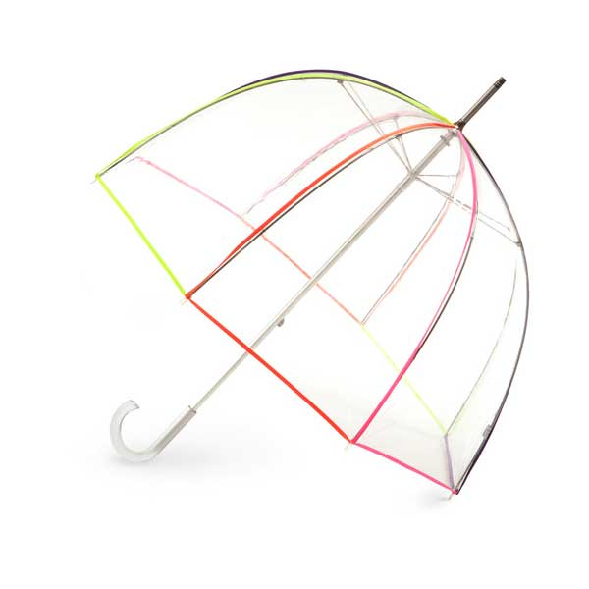
Step 1 – IE and HAES Principles
HAES = umbrella
IE, body acceptance and physical activity for movement, joy and health = spokes
weight neutral paradigm focused on health promoting behaviors
VS
weight and size based paradigm public health policy and medicine/nutrition are based upon
weight = OUTCOME

Slide 6
Step 1 – IE and HAES Principles
Intuitive Eating | Health At Every Size
• Reject the Diet Mentality • Honor Your Hunger • Make Peace with Food • Challenge the Food Police • Respect Your Fullness • Discover the Satisfaction Factor • Honor Your Feelings Without Using Food • Respect Your Body • Movement - Feel the Difference • Honor Your Health | Respects the diversity of body shapes and sizes Recognizes that health and wellbeing are multi-factorial (including physical, social, spiritual, occupational, emotional, and intellectual aspects) Promotes all aspects of health and well-being for people of all sizes Promotes eating in a manner which balances individual nutritional needs, hunger, satiety appetite and pleasure Promote individually appropriate, enjoyable, life enhancing physical activity vs exercise that is focused on the goal of weight loss
Notes:
Summarize by saying…
IE is not just eating what you want, whenever you want
HAES is not just “be fat and happy”
HAES not saying any person is healthy at any size
both these take the focus off of weight, size and eating based off of external factors
HAES still very much concerned with physical health but also recognizes the limitations of genetics, socioeconomic status, race, ethnicity, etc

Slide 7
IE and HAES Research
Intuitive Eating is associated with:
lowered risk of disordered eating/eating disorder
improved body image
self trust and better self esteem
improved emotional wellbeing
improved self efficacy
decreased weight cycling
lower BMI***
Notes:
I have lower BMI astericked b/c BMI unhelpful, inaccurate and harmful AND the goal of IE is NOT weight loss, rather supporting a person’s healthy set point. – but we do see lower BMI in Intuitive Eaters which suggests that people who eat in response to hunger and satiety cues, have unconditional permission to eat, and cope with feelings without only using food, are less likely to engage in eating behaviors that lead to weight gain beyond one’s natural set point.

Slide 8
IE and HAES Research
Health At Every Size research shows:
decreased weight cycling and weight gain
statistically and clinically relevant improvements in…
physiological measures (bp, lipids etc)
health behaviors (physical activity, eating disorder pathology, etc)
psychological outcomes (mood, self esteem, body image, self efficacy)
improved access to health care
higher retention
improved quality of life (reduced stigma and discrimination due to body size)

Slide 9
Step 2 - Weight Loss & Diet Research
Short term, people do lose weight BUT long term, up to 95% of dieters regain the weight they lost or even more within 3 years. Very few studies look beyond 2 years.
Dieting puts a person at risk for weight regain and a a higher set point due to weight cycling
Dieting causes physical, emotional, and spiritual distress
Person dieting ultimately “fails” → belief that health is contingent on narrowly defined body size
Discrimination and prejudice → perpetuate behaviors that lead to disordered eating + exercise habits
Discrimination and prejudice prevents people from seeking necessary healthcare
Fruh, S. M., Nadglowski, J., Hall, H. R., Davis, S. L., Crook, E. D., & Zlomke, K. (2016). Obesity Stigma and Bias. The Journal for Nurse Practitioners : JNP, 12(7), 425–432. http://doi.org/10.1016/j.nurpra.2016.05.013

Slide 10
“There is not a single study that demonstrates how to help people lose weight. Given the sheer volume of evidence of harm, a weight-centric approach is unethical.” - Marci Evans MS, CEDRD-S, LDN, cPT

Slide 11
In Summary….
diets don’t work → weight regain occurs due to:
decreased energy expenditure (due to metabolism slowing)
heighted reward response leading to increased drive to eat – survival mechanism
shift in leptin and ghrelin to encourage increased energy intake
Weight cycling increases overall inflammation which is known risk factor for chronic disease

Slide 12
Getting Honest with Ourselves
What are you own weight and health biases?
Do I make assumptions based only on weight regarding a person’s character, intelligence, professional success, health status, or lifestyle behaviors?
Am I comfortable working with people of all shapes and sizes?
Do I give appropriate feedback to encourage healthful behavior change?
Am I sensitive to the needs and concerns of people in larger bodies?
Do I treat the whole person or only the condition?
Notes:
We all have biases – myself included. Some of these might be implicit biases you aren’t even aware of. These questions can provide a starting point for a self assessment
Healthcare professionals typically don't view themselves as being biased. Because healthcare professionals are human, they have an unintentional "disconnect" between their desire to provide equal treatment and the way their clinical decision making is influenced by patients' race, ethnicity, socioeconomic status, and other social group membership traits, all of which are tenets of disparity.
Managing unconscious bias is difficult due to intrinsic blind spots. These blind spots may be the result of confirmation bias, which causes people to recognize information that reinforces their prior beliefs and disregard information that doesn't reinforce those beliefs. Trying to control this kind of bias requires constant vigilance and commitment to make a difference. When unconscious bias isn't recognized and managed, it may lead to healthcare disparities.

Slide 13
A Starting Point…
Personal awareness
Acknowledgment
Empathy
Advocacy
Education
Notes:
Tapping five strategies
Knowing that unconscious bias leads to disparity, nurses must try to eliminate it. The following five strategies may help.
1. Personal awareness. This is the process of looking inward to recognize beliefs and values that can lead to unconscious bias. Recognition can lead to the development of self-regulatory behaviors to mitigate the influence of bias on patient interactions.3 Acquiring personal awareness requires an internal compass that's used to guide daily interactions. This compass can help nurses recognize acceptable and unacceptable attitudes and behaviors and stay on the right path when faced with the continual threat of unconscious bias. It forces nurses to constantly look inward and creates an awareness of how they're perceived by others, laying the foundation for a therapeutic nurse-patient relationship.
2. Acknowledgment. Without acknowledgment that a problem exists, no action can be taken to solve the problem. With acknowledgment comes the acceptance of accountability and responsibility to make a difference. Nurses and other healthcare professionals must move to suppress unconscious bias by initiating responses to foster positive behaviors, such as empathy.
3. Empathy. Healthcare professionals must be able to empathize with patients and their circumstances to understand what they're feeling. Nurses can develop empathy by making a conscious effort to understand the patient's situation, become fully immersed in the patient's point of view, and get a sense of what it's like to be walking in the patient's shoes.4 Most people naturally have a sense of empathy, but some patients and situations can raise a barrier to empathy. For example, caring for patients who participate in risk-taking behaviors that result in adverse health outcomes can make it more difficult for a caregiver to be empathetic. Refusing to acknowledge this emotional necessity can produce negative outcomes during patient interactions and care. To overcome these barriers to empathy, healthcare providers must consciously make an effort to recognize and acknowledge that the barriers exist and deliberately implement a practice that aligns with unbiased patient care.
4. Advocacy. Support for patients as they navigate a complex healthcare system is called advocacy. Nurses can be patient advocates by assisting with communication with other members of the healthcare team, identifying best treatment options, and ensuring that a patient's rights aren't overlooked. In the presence of unconscious bias, nurses' advocacy can support patients to receive the individualized care they need. Nurses must advocate for patients with tact, compassion, and professionalism, and communicate and collaborate with other healthcare team members to support the patients' needs. Patients should be able to sense that their nurses intend to do what's best for them to provide safe outcomes.
5. Education. Enhanced knowledge is central to raising awareness, recognizing the existence of unconscious bias, and reducing its prevalence. Education can be introduced in formal curricula for healthcare providers and nurses. Another approach is to offer education that focuses on sensitivity and the existence of unconscious bias in healthcare facilities. Nurses can educate others during their daily interactions to raise awareness about the consequences of unconscious bias. Routine staff meetings can provide another forum for education, giving nurses an opportunity to share their experiences and beliefs and to explore options to mitigate this challenge. Educating others about unconscious bias helps create an environment that fosters equal treatment for all patients with an open and accepting approach. Besides strengthening the knowledge base, education creates an atmosphere promoting a strong nurse-patient relationship based on empathy and understanding, ultimately resulting in high-quality and equitable patient care.

Slide 14
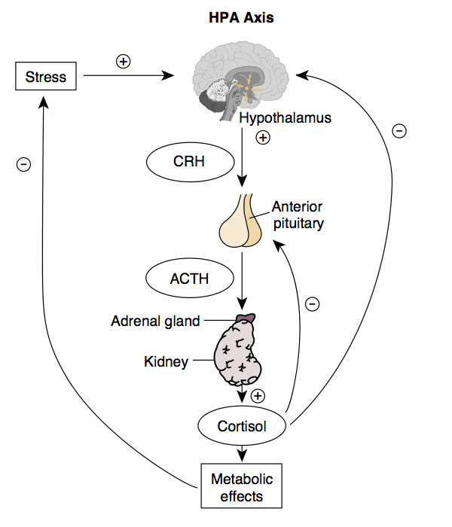
Step 3 - Physiological + Psychological
Activation of HPA = cortisol
nutrition, sleep, exercise and perceived stress
Effects of cortisol
blood sugar – glucose levels increase + insulin resistance develops → DM, PCOS, metabolic syndrome, HTN, CVD
appetite dysregulation - difficulty attuning to hunger
immune system suppression – difficulty fighting bugs
PSNS suppression – leads to GI issues
CVD – constriction + elevated BP → vessel damage
Fertility – disruption of HPG axis
Thyroid issues – inhibits TSH and prevents T4 → T3
repeated stress without rest leads to low grade chronic inflammation
Source: UNSW Embryology
Notes:
Primary role of HPA is to regulate the stress response – stress is not a bad thing, we need it to survive
Cortisol functions to reduce inflammation in the body, which is good, but over time, not so good. If the stress response isn’t counteracted by rest/recovery that’s where we get into trouble b/c we lose homeostasis. Chronic inflammation, caused by lifestyle factors, keep cortisol levels sky high which causes a a lot of dysregulation of the body’s systems.
Explain sources of stress
Explain HPA diagram
Talk about metabolic effects on slide

Slide 15
Step 3 - Physiological + Psychological
relationship with food → HPA activation
stress around food choices due to rules
guilt/shame around food
pressure to meet dietary expectations
monitoring food intake alone
intuitive eating → decreases perceived stress
focus on internal vs external cues
increased self esteem and self efficacy
eliminates food morality
doesn’t require food monitoring
TAKE HOME → people trust themselves, have better self esteem and self efficacy → less psychological stress → better physical health
Source: UNSW Embryology
Notes:
People who stress about food choices, feel guilt or shame around food, or feel pressure to meet dietary expectations are more likely to elicit the stress response which negatively impacts health, independent of food. Monitoring food intake alone (independent of restriction) Increases perceived stress.
IE decreases perceived stress

Slide 16
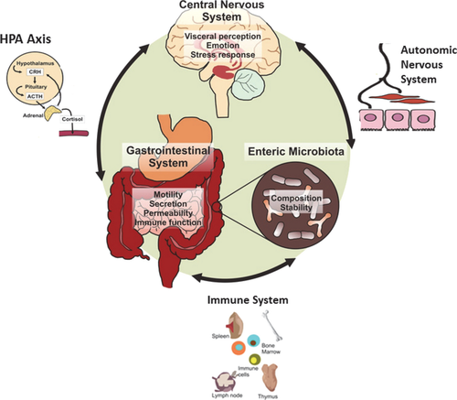
Step 3 – Stress and Your Gut
GBA involves complex communication between endocrine (HPA), immune and autonomic NS
Bi-directional via the Vagus nerve (CN X)
stressed out person = stressed out gut
repeated stress = decreased amount & variety of flora
chronic stress → alters intestinal permeability → low grade inflammation
Healthy gut = more resistant to stress & toxins → less disease and chronic inflammation
Clarke, G., Omahony, S., Dinan, T., & Cryan, J. (2014). Priming for health: Gut microbiota acquired in early life regulates physiology, brain and behaviour. Acta Paediatrica, 103(8), 812-819. doi:10.1111/apa.12674
Notes:
The GBA involves complex crosstalk between the endocrine (hypothalamic-pituitary-adrenal axis), immune (cytokine and chemokines) and the autonomic nervous system (ANS).
vagal neurons carry feedback from the intenstine to the brain stem → engages the hypothalamus and limbic system (responsible for regulation of emotions). Similarly, descending projections from the limbic system (activated via stress) influence autonomic activity of the gut
We do want some intestinal permeability, which allows nutrients to pass through the gut, while also maintaining a barrier function to keep potentially harmful substances from leaving the intestine and migrating to the body where they shouldn’t be. Increased IP is where we get into trouble.
HEALTHY GUT → healthy intestinal microflora + healthy IP (epithelial barrier) = harmful substances stay where they should and don’t interact with the mucosal-associated immune system = development of appropriate immune responses (vs constant/uncontrolled) → protects against disease and chronic inflammation
consistent stress negatively affects the amount and diversity of your good gut flora.

Slide 17
Step 3 –Improving Gut Health
We can’t ignore the role of early infancy – mode of birth, antibiotic use and infant feeding method
NSAIDS, antibiotics and other meds - affect gut flora diversity and permeability
Probiotics and Prebiotics - helps in restoring the microbiome – need both
Dairy??
Gluten
gliadin activates zonulin (protein regulating tight junctions) → increased IP in everyone → controlled immune response mounted → body returns to homeostasis
celiac disease → compromised immune system → harder time cleaning up → problems (destruction of villi)
gluten sensitivity → perhaps larger inflammatory response? diagnosis? more questions than answers
a healthy immune system can deal with gluten just fine (what about those with autoimmune dx?)
****Reduce Stress – both physical and emotional***
Nutrition - this isn’t complicated and rigid → think gentle nutrition
encourage nourishing foods like fruits, vegetables, beans/legumes, minimally processed grains, healthy fats, omega 3 rich fish – variety is key!
Genetics certainly play a role which we cannot control
Notes:
Dr. Alessio Fasano is doing really good research → Pediatric Gastroenterologist at MGH and Director of the Center for Celiac Research
celiac vs non celiac GS → we don’t actually know what GS is, there are no biomarkers, we just know it’s not CD or a wheat allergy because that must be diagnosed with a blood test for specific Abs and confirmed with an intestinal biopsy

Slide 18
Step 3 – Emotions and Stress
self esteem = value and respect for oneself & body
impacts how you take care of yourself
low self esteem increases cortisol levels
self efficacy = one’s belief in their ability to reach a goal
degree of self efficacy influences behavior change
higher self efficacy = lower anxiety about change
sources
past personal successes,
watching others succeed
encouragement
emotional and physiologic state (+ or - emotions)
imaginative experiences (visualization)
how can we promote better self efficacy through our treatment approach?
Notes:
Research shows that self-efficacy matters. Degree of self-efficacy influences choices about behavior change including:
whether or not to make a change
how high to set the goal
amount of effort someone is willing to put into a change
how long they will persevere in the face of obstacles.
Finally, research has shown that people with higher self-efficacy = lower anxiety about changes and tend to spend less time thinking about personal deficits or barriers and dedicate more time to achieving their goals.

Slide 19
In summary…
Stress has huge impacts on our health – cortisol affects many body systems
Gut health plays an important role
Behaviors/thoughts/feelings about food are significant contributors to HPA activation
Intuitive eaters tend to trust themselves, have better self esteem and self efficacy and therefore have less psychological stress leading to better physical health
People with healthy self esteem, body image and mental health are more likely to engage in health promoting behaviors

Slide 20
Case study
Rachael is a 31 year old female who is referred to you for nutrition counseling. After her physical exam with her PCP, her lab values are diagnostic for hyperlipidemia and T2DM. She has possible PCOS that will need to be further worked up to confirm diagnosis and she has a positive ANA. Her BMI is 32.4.
Her history includes chronic dieting, weight loss and gain +/- 40 lbs, skipping meals and her sleep schedule is up and down – most nights she’s in bed by 1am to 2am and up around 7am or 8am. On weekends she sleeps until 12pm or 1pm.
Over the past year she has changed jobs, taken care of her sick father who passed away and ended a 4 year relationship. She does not report any over eating or binge eating. 24 hour dietary recall is as follows:
Wakes around 7am
Drinks black coffee until 11am
11:30am to noon – ½ cup oatmeal with fruit, ~1 tbsp. chia seeds, ~ 1 tbsp. peanut butter and almond milk
9pm dinner includes take out burrito with side or chips and guac (~ ½ cup)
What is your assessment of this client?
Notes:
health issues not directly related to food/exercise – this is a very complex picture
self esteem and self efficacy are likely low
HPA dysregulation
blood sugar issues which could be causing PCOS hormonal picture
something is going on with her immune system
circadian rhythm disruption

Slide 21
Step 4 – Health As A Whole
Health is dynamic - social, psychological, economic, racial, physical and emotional - this broader lens allows us to provide evidence based and ethical care
CONSIDER THIS…
Many factors disrupt the HPA axis, leading to a stress response and inflammation.
Illness and disease is a manifestation of underlying inflammation.
WHAT is causing the underlying inflammation?

Slide 22
Step 4 – Health As A Whole
Based on the research…
Exercise? Moderate to high intensity exercise increases cortisol vs low intensity exercise
Sleep? Sleep deprivation alone leads to a systemic increase of inflammatory mediators → disruption of inflammatory homeostasis → insulin resistance, increased BP, and CVD
Stress? Stress itself alters body systems → psychological distress - possibly the precursor of high metabolic risk (e.g. dyslipidemia, elevated BP, high fasting BG).
**which could be why we see more of these disease states in lower SES communities
focusing on nutrition is fruitless if we neglect all these other aspects of health
Notes:
obviously illness and disease is a combo of genetic and many environmental factors!!

Slide 23
Step 4 – How we can help, not hurt
we must foster behavior changes by using strategies that reduce, rather than increase psychological stress
Consider these…
take a thorough history and LISTEN
build a relationship with the patient that cultivates trust, compassion and mutual respect
take all components of a person’s life and health into consideration – biopsychosocial
make a comprehensive and accurate assessment - think outside the box
THEN develop an evidence based treatment plan unique to that individual’s needs
RESULT → ethical and effective care that helps people get truly healthy
Notes:
More often than not, food is not the primary contributor to overall stress & inflammation
use MI!!
don’t walk around in a dark room

Slide 24
Step 5 – Implementing IE and HAES
HAES applies to anyone and everyone in any situation → it is not anti-health
IE = head knowledge + body knowledge
***we turn up the mind knowledge when body signals are confusing and/or unreliable
autoimmune disease
GI issues
healing from a surgery or trauma
insomnia, stress, athletic performance or excessive exercise
insulin resistance [PCOS, diabetes etc]
certain medications like anti-psychotics and stimulants
severe health conditions [cancer, ESRD, IBD, true food allergies etc]
an eating disorder or history of restriction is present****
Notes:
Remember that HAES is a weight neutral paradigm focused on behaviors – it is not anti-health

Slide 25
Step 6: Developing a diet neutral, effective plan of care
health
health
weight
Notes:
we do not have to pursue weight loss in order to pursue health
WEIGHT IS AN OUTCOME not a behavior change

Slide 26
Step 6: Developing a diet neutral, effective plan of care
health
nutrition

Slide 27
Gentle Nutrition
Good nutrition isn't rigid, restrictive, or complicated – let’s not miss the forest for the trees
Individual
foods
Variety
Balance
Adequacy
Image based on Rachael Hartley’s Nutrition Hierarchy of Needs
Notes:
https://www.rachaelhartleynutrition.com/blog/how-to-practice-gentle-nutrition-in-intuitive-eating
eating every 3-4 hours (that’s rhythmic for the GI system and the blood sugar and HPA) get in all macros at meals (use plate method handout) – details don’t matter unless you lay a foundation
focus on ADDING - SPECIFICALLY, HOW TO INCLUDE MORE NUTRIENT-DENSE FOODS
we will go over this in the last part of the case study
include a variety of foods – experiment with taste buds and set up food experiments
self attunement b/c people more motivated by intrinsic factors – can be helpful to keep IE journal for a week (how they felt physically and mentally before/after a meal)
it’s less stressful, doesn’t mean ALWAYS but you can be more creative etc – have friends over etc etc – this helps them get the positive feedback of feeling GOOD --- think of it as a stepping stone as they build skills and confidence
whenever someone has to make food modifications for their health (celiac, T1DM, true food allergies etc) ensure they are having FREQUENT satisfying food experiences
support system, create space for self care (grocery shopping, time to get outside and walk, etc etc

Slide 28
Role of Gentle Nutrition
FOCUS ON THE BOTTOM 3 TIERS FIRST – individual foods will have little to no effect if these aren’t met
FOCUS IS ON INCLUSION VS EXCLUSION – fruits and veggies, fiber rich foods, healthy fats, more plants
EAT DAIRY IF YOU ENJOY IT – go for full fat and grass fed if you can afford it
BE MINDFUL AROUND SWEETS
PAY ATTENTION TO HOW FOOD MAKES YOU FEEL
PREPARE YOUR OWN FOOD MORE OFTEN & EMPHASIZE FRESH FOODS
ENCOURAGE FREQUENT SATISFYING FOOD EXPERIENCES
CULTIVATE A HEALTH PROMOTING ENVIRONMENT
Notes:
https://www.rachaelhartleynutrition.com/blog/how-to-practice-gentle-nutrition-in-intuitive-eating
eating every 3-4 hours (that’s rhythmic for the GI system and the blood sugar and HPA) get in all macros at meals (use plate method handout) – details don’t matter unless you lay a foundation
focus on ADDING - SPECIFICALLY, HOW TO INCLUDE MORE NUTRIENT-DENSE FOODS
we will go over this in the last part of the case study
include a variety of foods – experiment with taste buds and set up food experiments
self attunement b/c people more motivated by intrinsic factors – can be helpful to keep IE journal for a week (how they felt physically and mentally before/after a meal)
it’s less stressful, doesn’t mean ALWAYS but you can be more creative etc – have friends over etc etc – this helps them get the positive feedback of feeling GOOD --- think of it as a stepping stone as they build skills and confidence
whenever someone has to make food modifications for their health (celiac, T1DM, true food allergies etc) ensure they are having FREQUENT satisfying food experiences
support system, create space for self care (grocery shopping, time to get outside and walk, etc etc

Slide 29
TAKE HOME POINT
IE is very individualized and will look different for everyone. Be patient, creative and empathetic - partner with your clients.
Notes:
45 minutes

Slide 30
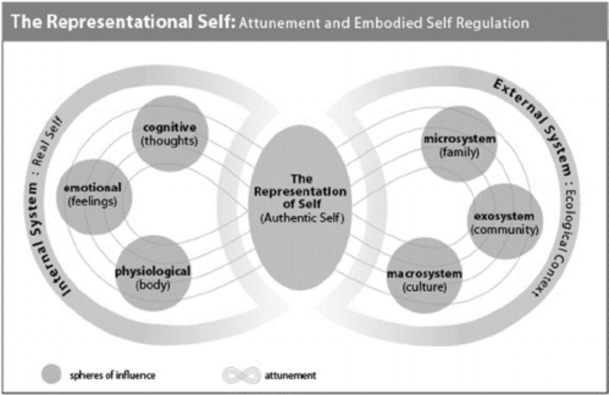
Step 6: Developing a diet neutral, effective plan of care
Embodied self-regulation and mindful self-care in the prevention of eating disorders - Scientific Figure on ResearchGate. Available from: https://www.researchgate.net/figure/The-Attuned-Representational-Model-of-Self-ARMS-In-the-center-the-representational_fig2_286639645 [accessed 19 May, 2021]
Notes:
Ok so what can we focus on in our work with people?
1. mind knowledge can come in when body signals get confusing and/or there are medical diagnoses involved that alter a body’s ability to give out fully reliable body signals
2. increase awareness of body responses – help people choices that make them feel physically, emotionally and psychologically well
3. nutrition education should be objective, informative and empowering, not tied to morality, wrapped in judgement or focused on weight →
4.

Slide 31
Three Questions To Ask
1st
What does healthy mean to you?
2nd
How do you feel about _____?
helps gauge their perception/feelings/values around health & behaviors (not yours)
3rd
How do you FEEL physically when you eat _____?
allows you to hear from them vs projecting your agenda onto the patient/client
How do you feel mentally/emotionally when you eat _____?
helps you gently direct the person back to internal cues and wisdom
Notes:
practical application: questions you can ask when helping people develop better internal attunement

Slide 32
Remember THIS…
By focusing on all these other factors, besides weight and purely objective measures, you give people permission to do the same for themselves

Slide 33
Keys to Effective + Ethical Care
effective care
compassion
encourage self care vs rules
food is neutral
body wisdom
values based
reserve judgement
need variety of nourishment
motivational interviewing
Notes:
should be delivered from a compassion-centered approach that encourages self-care versus a set of rules/guidelines to meet expert guidelines.
Food is neutral. There are no good or bad foods, rather different foods nourish our bodies in different (but still important) ways.
Emphasize the need for all kinds of nourishment (psych, physical, spiritual, etc overall and long term, but also the need for one over the other given their body’s particular needs. Kale, for example, primarily provides physical nourishment through nutrients. Cupcakes primarily provide emotional and psychological nourishment, satiation AND satisfaction.
We are helping guide clients/patients back to their own internal wisdom – THEY are the experts.
Value based care is huge – how do we help people make behavior change in line with their own values (not ours)
Reserve judgement and speak to how food impacts their body from a physiological perspective. There is no “end all be all” -- as your body heals, it becomes more resilient.
Utilize loose structure if needed (for example: The Plate Method) to help guide them.
Use motivational interviewing to help people reflect on how foods make them FEEL, what is important to them, etc and to help a client through shared decision making

Slide 34
Our Case Study Continued…
Using Rachael from our case study in Step 3, let’s apply what we’ve learned to create a plan of care...
Are there additional questions you would want to ask in order to get a comprehensive assessment and form an appropriate plan of care?
Notes:
Additional questions….
dig into her dieting and weight hx → does she feel hunger/fullness?
mental health or other medical dx?
supplements or medications?
is she menstruating? menstrual hx?
any pertinent family hx?
stress levels – how does she handle stress?
any food rules? how would she describe her relationship with food?
exercise routine? how would she describe her relationship with exercise?
how does SHE feel about her health? does she have any goals? what would she like to get out of your work together?

Slide 35
Our Case Study Continued…
How would we go about beginning work with Rachael in a way that increases her self efficacy while improving her health?
Notes:
Ask what feels important to HER? if she has no idea you could start with a SMALL, FEASIBLE STEP.
Think about the nutrition hierarchy of needs while also taking into consideration the psychological impact of a change by dialoguing with her
What do you think about laying down a rhythmic pattern of eating? For example… what are you thinking and feeling as I say that?
Ok, let’s start with breakfast…
There is power in focusing on one thing at a time. Is she open to eating breakfast/upon waking? What kind of breakfast? What would be easiest for her? Satiating granola bar + fruit with her coffee. piece of pb toast + fruit if at home.
Increase self efficacy → Has she had experiences in the past where she set a goal and reached it? How did she do that? What was helpful for her in that?
Ask 7/10 scale

Slide 36
Our Case Study Continued…
Using the IE/HAES framework, how could we provide some nutrition education to Rachael using diet neutral language?
Notes:
This would happen DOWN THE ROAD as you move on from adequacy…it could take weeks/months to develop a rhythmic pattern of eating…
when it comes to balance … Including a protein and/or fat source when you eat carbohydrates will help stabilize your blood sugar so sugar enters the bloodstream in a more steady way…imagine pouring water through a funnel vs dumping it from one container into another
when talking about variety --- encouraging her to ADD in more fruits and vegetables which provide antioxidants and phytonutrients that help with inflammation
THEN you could focus on individual foods way down the road

Slide 37
Wrapping It All Up
Focusing on health and not weight allows us to provide effective, ethical care
We have to work through our own weight and health bias to provide quality care
Our psychological health deeply impacts our physical health, we have to consider both
Many factors contribute to health - we have to view health through this broader lens
Intuitive Eating is highly individualized, therefore we have to be creative when helping people achieve health and peace with food
Provide nutrition education in a way that EMPOWERS people to best care for themselves and continually directs people back to their internal body wisdom

Slide 38
Thank you!

Slide 39
References
Garner DM, Wooley S. Confronting the failure of behavioral and dietary treatments for obesity. Clinical Psychology Review, 1991; 11:729-780.
Mann T, et al. (2007). Medicare’s search for effective obesity treatments: Diets are not the answer. American Psychologist, 62(3), 220-233.
Karelis AD, et al. (2008). Metabolically healthy but obese women: effect of an energy-restricted diet. Diabetologia, 51:1752-1754.
Flum, DR, et al., Early mortality among Medicare beneficiaries undergoing bariatric surgical procedures, JAMA. 2005;294:1903-1908. Int J Obes Relat Metab Disord. 2004 Sep;28(9):1134-42.
Strohacker K, McFarlin B: Influence of obesity, physical inactivity, and weight cycling on chronic inflammation. Front Biosci. 2010, E2: 98-104. 10.2741/e70.
Carabotti, M., Scirocco, A., Maselli, M. A., & Severi, C. (2015). The gut-brain axis: interactions between enteric microbiota, central and enteric nervous systems. Annals of Gastroenterology : Quarterly Publication of the Hellenic Society of Gastroenterology, 28(2), 203–209.
McEwen, B. S. (2008). Central effects of stress hormones in health and disease: understanding the protective and damaging effects of stress and stress mediators. European Journal of Pharmacology, 583(2-3), 174–185. http://doi.org/10.1016/j.ejphar.2007.11.071
Ranabir, S., & Reetu, K. (2011). Stress and hormones. Indian Journal of Endocrinology and Metabolism, 15(1), 18–22. http://doi.org/10.4103/2230-8210.77573
Notes:
Kelly, J. R., Kennedy, P. J., Cryan, J. F., Dinan, T. G., Clarke, G., & Hyland, N. P. (2015). Breaking down the barriers: the gut microbiome, intestinal permeability and stress-related psychiatric disorders. Frontiers in Cellular Neuroscience, 9, 392. http://doi.org/10.3389/fncel.2015.00392

Slide 40
References
K. Vakharia, J. P. Hinson; Lipopolysaccharide Directly Stimulates Cortisol Secretion by Human Adrenal Cells by a Cyclooxygenase-Dependent Mechanism, Endocrinology, Volume 146, Issue 3, 1 March 2005, Pages 1398–1402, https://doi.org/10.1210/en.2004-0882
Janeiro BKR, Cotoner CA, Pigrau M, Lobo B, Vicario M, , Santos J. Role of Corticotropin-releasing Factor in Gastrointestinal Permeability. J Neurogastroenterol Motil 2015;21:33-50. https://doi.org/10.5056/jnm14084
Fasano, A. (2012). Zonulin, regulation of tight junctions, and autoimmune diseases. Annals of the New York Academy of Sciences, 1258(1), 25–33. http://doi.org/10.1111/j.1749-6632.2012.06538.x
Vanuytsel T, van Wanrooy S, Vanheel H, et al. Psychological stress and corticotropin-releasing hormone increase intestinal permeability in humans by a mast cell-dependent mechanism. Gut 2014;63:1293-1299.
Vazquez-Roque, M. I., Camilleri, M., Smyrk, T., Murray, J. A., Marietta, E., O’Neill, J., … Zinsmeister, A. R. (2013). A Controlled Trial of Gluten-Free Diet in Patients with Irritable Bowel Syndrome-Diarrhea: Effects on Bowel Frequency and Intestinal Function. Gastroenterology, 144(5), 903–911.e3. http://doi.org/10.1053/j.gastro.2013.01.049
http://www.heretohelp.bc.ca/factsheet/body-image-self-esteem-and-mental-health
Gagnon-Girouard, M.-P., Bégin, C., Provencher, V., Tremblay, A., Mongeau, L., Boivin, S., & Lemieux, S. (2010). Psychological Impact of a “Health-at-Every-Size” Intervention on Weight-Preoccupied Overweight/Obese Women. Journal of Obesity, 2010, 928097. http://doi.org/10.1155/2010/928097
Strecher VJ, DeVellis BM, Becker MH, Rosenstock IM. The role of self-efficacy in achieving health behavior change. Health Educ Q. 1986 Spring;13(1):73-92. http://positivepsychology.org.uk/self-efficacy-definition-bandura-meaning/
Notes:
Kelly, J. R., Kennedy, P. J., Cryan, J. F., Dinan, T. G., Clarke, G., & Hyland, N. P. (2015). Breaking down the barriers: the gut microbiome, intestinal permeability and stress-related psychiatric disorders. Frontiers in Cellular Neuroscience, 9, 392. http://doi.org/10.3389/fncel.2015.00392

Slide 41
References
"A Literature Review on the Connection between Stress and Self-Esteem" written by Michael J. Galanakis, Anastasia Palaiologou, Georgia Patsi, Ioanna-Maria Velegraki, Christina Darviri, published by Psychology, Vol.7 No.5, 2016
Guseman, Emily & Zack, E & Battaglini, Claudio & Viru, Mehis & Viru, A & Hackney, Anthony. (2008). Exercise and circulating Cortisol levels: The intensity threshold effect. Journal of endocrinological investigation. 31. 587-91. 10.1007/BF03345606.
Mullington, J. M., Simpson, N. S., Meier-Ewert, H. K., & Haack, M. (2010). Sleep Loss and Inflammation. Best Practice & Research. Clinical Endocrinology & Metabolism, 24(5), 775–784. http://doi.org/10.1016/ j.beem.2010.08.014
Vanuytsel T, van Wanrooy S, Vanheel H, et al. Psychological stress and corticotropin-releasing hormone increase intestinal permeability in humans by a mast cell-dependent mechanism. Gut 2014;63:1293-1299.
Gibson PR. Increased gut permeability in Crohn’s disease: is TNF the link? Gut 2004;53:1724-1725.
Tribole E, Resch E. Intuitive eating: a revolutionary program that works. New York: St. Martins Griffin; 2012.
Bacon L. Health at every size the surprising truth about your weight. Dallas: Benbella Books; 2010.
FitzGerald, C., & Hurst, S. (2017). Implicit bias in healthcare professionals: a systematic review. BMC medical ethics, 18(1), 19. https://doi.org/10.1186/s12910-017-0179-8
Yang, I., Corwin, E. J., Brennan, P. A., Jordan, S., Murphy, J. R., & Dunlop, A. (2016). The Infant Microbiome: Implications for Infant Health and Neurocognitive Development. Nursing research, 65(1), 76–88. https://doi.org/10.1097/NNR.0000000000000133
Notes:
Kelly, J. R., Kennedy, P. J., Cryan, J. F., Dinan, T. G., Clarke, G., & Hyland, N. P. (2015). Breaking down the barriers: the gut microbiome, intestinal permeability and stress-related psychiatric disorders. Frontiers in Cellular Neuroscience, 9, 392. http://doi.org/10.3389/fncel.2015.00392

Slide 42
Resources for More Learning
Intuitive Eating Workbook by Evelyn Tribole, MS, RDN and Elyse Resch, MS, RDN
Body Respect by Linda Bacon
The Happiness Trap by Russ Harris
Body of Truth by Harriet Brown
Gut by Giulia Enders
The Non-Diet Approach Guidebook for Dietitians: A How-To Guide for Applying the Non-Diet Approach to Individual Dietetic Counselling by Fiona Willer
Association of Size Diversity and Health | https://www.sizediversityandhealth.org
Intuitive Eating webpage | http://www.intuitiveeating.org/10-principles-of-intuitive-eating/
Gentle Nutrition by Rachael Hartley
Unpacking Weight Science | https://www.unpackingweightscience.com
Podcasts
Nutrition Matters with Paige Smathers
Don’t Salt My Game with Laura Thomas
Food Psych with Christy Harrison
Dietitians Unplugged Podcast
Body Love Project with Jessie Haggerty
The Mindful Dietitian with Fiona Sutherland
Notes:
Kelly, J. R., Kennedy, P. J., Cryan, J. F., Dinan, T. G., Clarke, G., & Hyland, N. P. (2015). Breaking down the barriers: the gut microbiome, intestinal permeability and stress-related psychiatric disorders. Frontiers in Cellular Neuroscience, 9, 392. http://doi.org/10.3389/fncel.2015.00392

